Slide 1
● Case Study
Moped focus is Affordability and ease of use [Everyone explore SC and MC….no one in Moped]
Highest market [hero] strong is High fuel Efficiency and Maintenance Cost
2nd Highest Honda → Fuel Efficient and Advanced Safety Features
For Export Need → Performance Bikes
Cult Following or Lifestyle Focusing Kind of Trend to be Created in EV
Globally EV Growth @7.2%
The Indian market excels in affordability, local adaptation, and rural penetration, while the global industry is characterized by innovation, strong brand equity, and diverse product offerings

Slide 2
● India Market
Globally EV Growth @7.2%
 |  | No of OEMs | Total EV Volume | Total 2W Volume | EV in Mill | Pecentage of EV
2019-20 | FY20 | 6 | 26,834 | 15.12 | 0.03 | 0.18
 | FY21 | 11 | 44,803 | 17.42 | 0.04 | 0.26
 | FY22 | 12 | 252,641 | 13.57 | 0.25 | 1.86
 | FY23 | 13 | 728,054 | 15.86 | 0.73 | 4.59
2023-24 | FY24 | 13 | 944,126 | 17.97 | 0.94 | 5.25

Slide 3
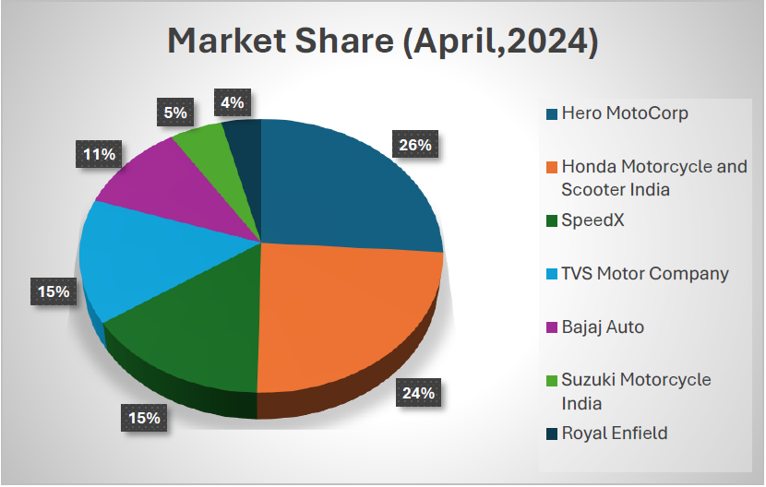
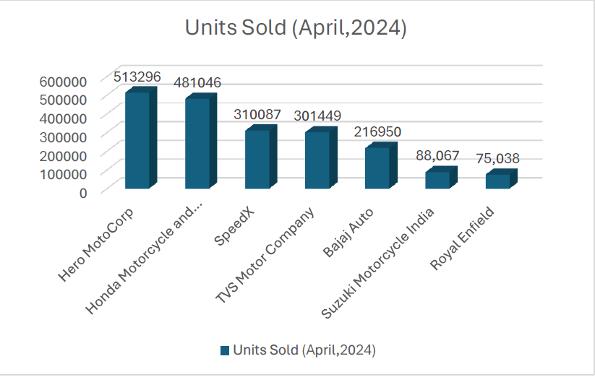
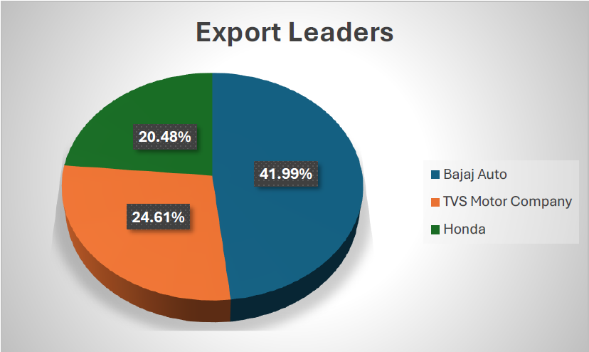
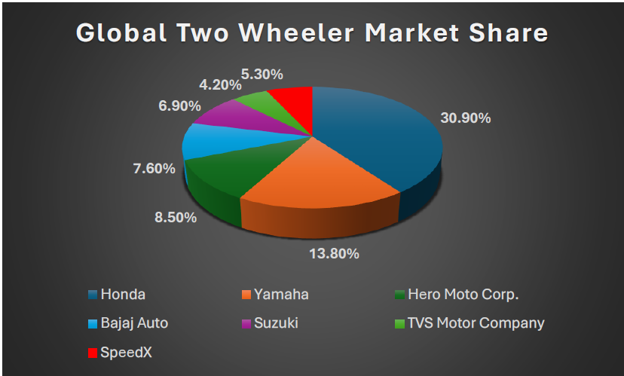
● Case Study

Slide 4
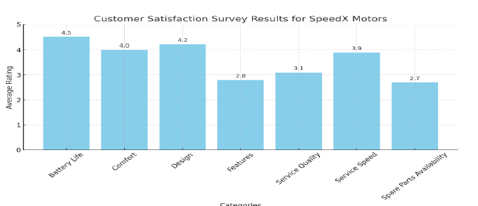
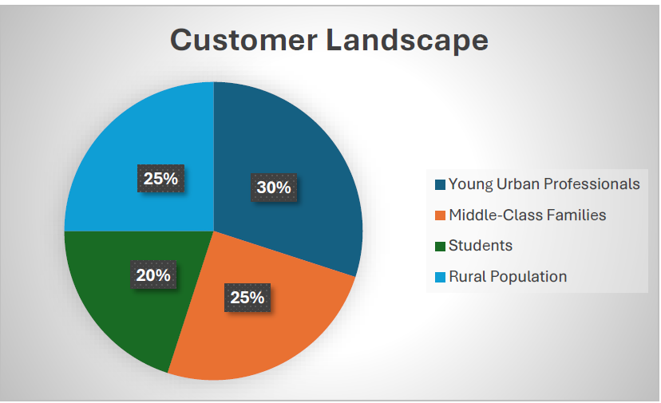
● Case Study

Slide 5
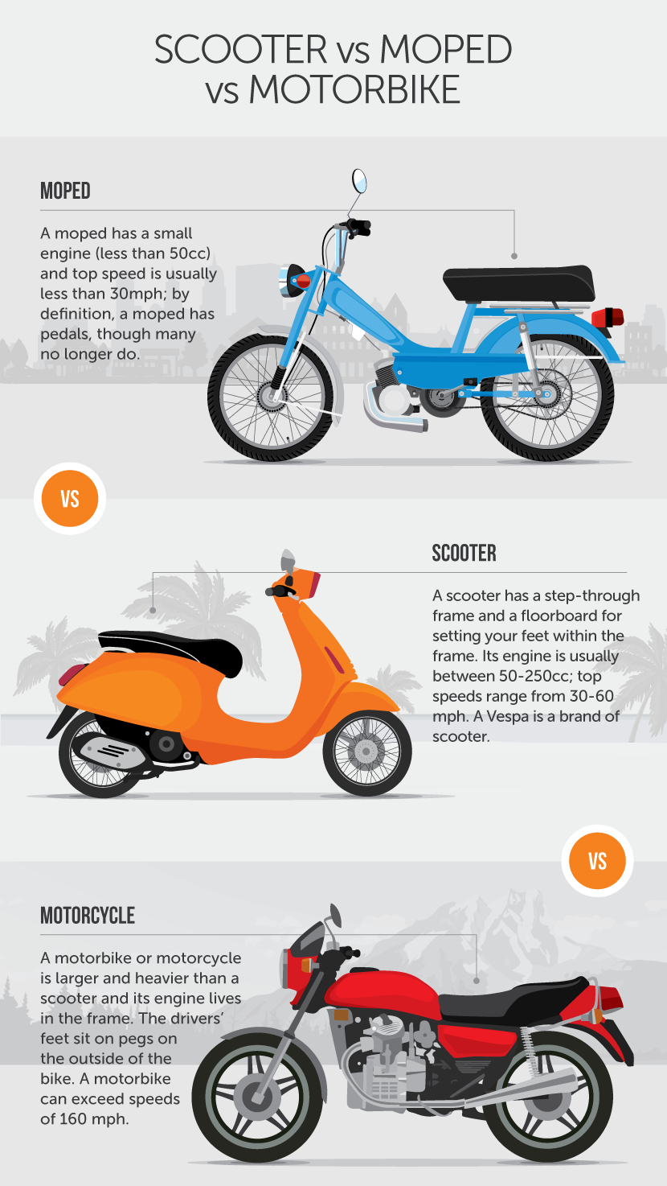
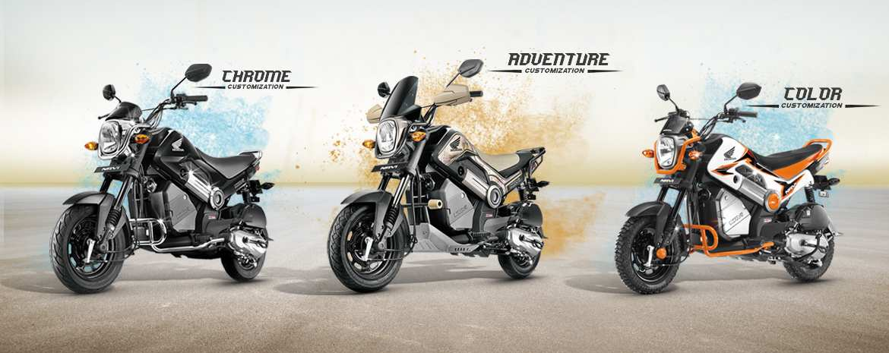
NAVI

Slide 6
● Case Study
Strength Strong R&D Hold Have Proprietary Technologies leads to low Child part Costs 15% Market Share & Good Feeback about Product Performance | Weakness Only Single model in India till date Less Features, Service Quality, Spare Parts Availability, Speed of Service No Export Market till date from India
Opportunities Explore Motorcycle & Moped like NAVI with Multiple Variants Customization/Personalization and Cult Following Exploration of low-cost manufacturing in India to Export Models CKD or CBU Development of Local Supplier to reduce Dependency on Global Supply Chains with help of PLI and FAME2 Adoption of Circular Economy → Get RM At low Cost Penetration into Rural with Solar Panel and Swapable Battery Options [Addressing all Concerns of Rural Area] FAME II & PLI To boost Localization and Battery mfg. | Threats Charging Infrastructure Highly Completive Market Less Brand Value Compared to Others, there by Impacting Trust of Customers Supply Chaing Disruptions Focus on Sustainability and Cleaner process Economic Factors – Low Purchase power Quick Changes in Customer Preferences Limited access to reliable service centers in rural areas

Slide 7
● Develop a roadmap for expanding SpeedX Motors's market share to 30% in the next 2 years
Model 1 Development
With Customizations
Swapable batteries
Sustainable in Rural Environment
Multi variants to Cater Urban and Rural
Rural Charging Infrastructure
Mobile Charging Set up
Export Business Starting
With Customizations
CKD
CBU
Review and Expand B2B iboth Domestic and International
40%
Recycle and OEM Collaborate
Aluminum , Frame Body, Battery
Localization
Major Import child parts to become Self Realian and utilize FAME II , PLI
Extensive Market Survey
Feature Requirement
Rural Infrastructure Study for EV Sustainability
Customer Acceptance for Moped EV
Service Improvement
Service Training [efficiency up]
Ai utilize for Spare part Requirement
30%
Model 2 Development
Performance Focus
Export Quality
Customizations
B2B Collaborations for Micro Mobility
15%
3months
9 months
15 Months
21 Months
24 Months
Brand Enhancement by Participating in CSR and Associating with last Mil Delivery Ageencies and B2B Collaborations
Continuous PDCA and Market Customer Feedback taking and Immediate action on it

Slide 8
● What steps can SpeedX take to establish a unique market position and become the preferred choice or its targeted customer group?
120% Meeting the Expectation of Customers in terms of Performance Requirement
Good Service & Faster Problem Resolution with Customer Centric Approach with Long term Vision
Contributing to Environment Through Circular Economy, Mobility Solutions

Slide 9
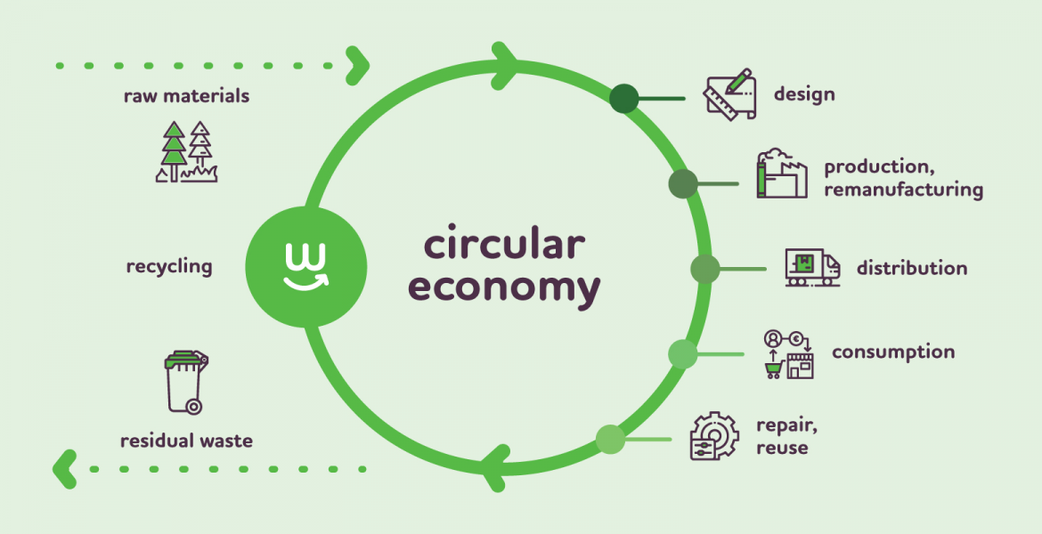
● How can SpeedX align its commitment towards society and sustainability goals to create a roadmap for social responsibility?
SDG 3: Ensure healthy lives and promote well-being for all at all ages → Propose E Bicycles, Mopeds like NAVI Concept in Developing Nations and Improvement of EV Technologies
SDG 6: Ensure availability and sustainable management of water and sanitation for all --> Circular Economy to Extend the product life Cycle and Enhance Value
SDG 7: Affordable and Clean Energy: Ensure access to affordable, reliable, sustainable, and modern energy for all. → Propose Solar Umbrella and Surya Ghar Yojana
SDG 9: Build resilient infrastructure, promote inclusive and sustainable industrialization and foster innovation. →Solar roof Tops, Piezo Electric Foot Path, Wind Turbine in Vehicle movement Area, Charging Stations, Rainwater Harvesting
SDG 11: Make cities and human settlements inclusive, safe, resilient and sustainable. → Sustainable Transport through Most Efficient Design, Rent basis Bike Sharing Network
SDG 12: Ensure sustainable consumption and production patterns. → Scrap Policy and Recycled Material, Environmentally Friendly Packaging & Sustainable Transport Routes

